Slide 1
TREE DIAGRAMS

Slide 2
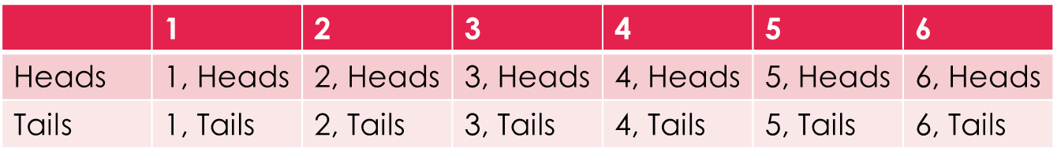
Revision
a dice is thrown and a coin is tossed.
Determine the possible outcomes
P(4) =
P(heads) =
P(3 and tails) =
P(even number) =

Slide 3
24
7
30
Date
Tree Diagrams
EQ – How can use a tree diagram to calculate probabilities?
A bag contains 2 red counters and 3 blue counter. Two counters are chosen the colour noted and replaced. Draw a tree diagram showing the possible outcomes and the probabilities.
9

Slide 4
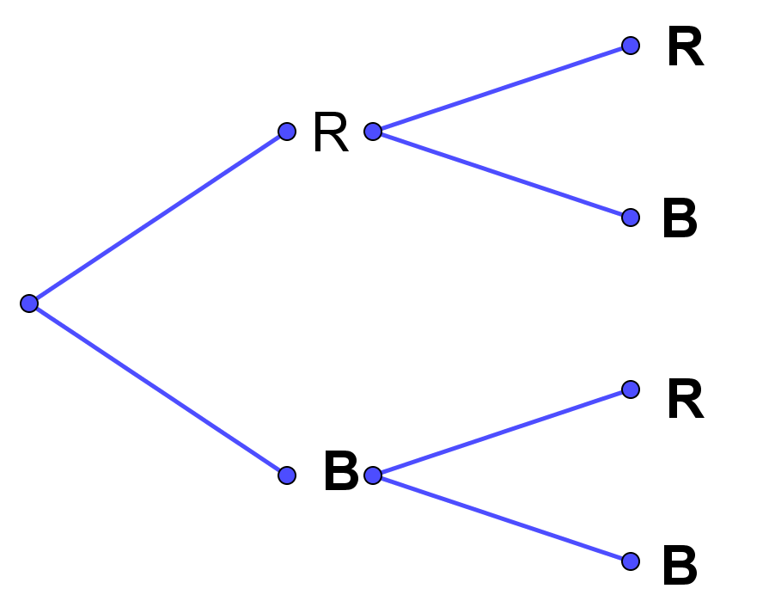

24
7
30
Date
Tree Diagrams
EQ – How can use a tree diagram to calculate probablities?
A bag contains 2 red counters and 3 blue counter. Two counters are chosen the colour noted and replaced. Draw a tree diagram showing the possible outcomes and the probabilities.
First
Second
$$\frac{2}{5}$$
$$\frac{2}{5}$$
$$\frac{3}{5}$$
$$\frac{2}{5}$$
$$\frac{3}{5}$$
$$\frac{3}{5}$$
9

Slide 5
24
7
30
Date
Tree Diagrams
EQ – How can use a tree diagram to calculate probablities?
A bag contains 2 red counters and 3 blue counter. Two counters are chosen the colour noted and replaced. Draw a tree diagram showing the possible outcomes and the probabilities.
First
Second
Outcome
$$\frac{2}{5}$$
RR
$$\frac{2}{5}$$
$$\frac{3}{5}$$
RB
$$\frac{2}{5}$$
$$\frac{3}{5}$$
BR
$$\frac{3}{5}$$
BB
9

Slide 6




24
7
30
Date
Tree Diagrams
EQ – How can use a tree diagram to calculate probablities?
A bag contains 2 red counters and 3 blue counter. Two counters are chosen the colour noted and replaced. Draw a tree diagram showing the possible outcomes and the probabilities.
First
Second
Outcome
Probability
$$\frac{2}{5}$$
RR
$$\frac{2}{5}×\frac{2}{5}=\frac{4}{25}$$
$$\frac{2}{5}$$
RB
$$\frac{2}{5}×\frac{3}{5}=\frac{6}{25}$$
$$\frac{3}{5}$$
$$\frac{2}{5}$$
$$\frac{3}{5}×\frac{2}{5}=\frac{6}{25}$$
$$\frac{3}{5}$$
BR
$$\frac{3}{5}$$
BB
$$\frac{3}{5}×\frac{3}{5}=\frac{9}{25}$$

Slide 7
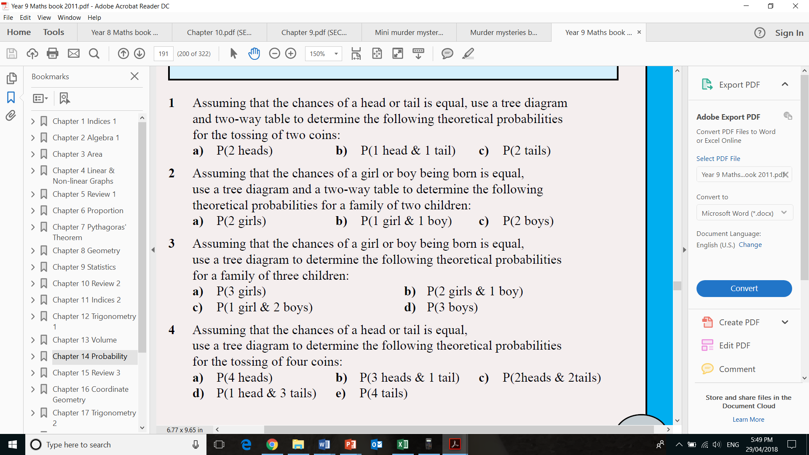

Slide 9
Worksheet

